Slide 1
Combinational Logic

Slide 2
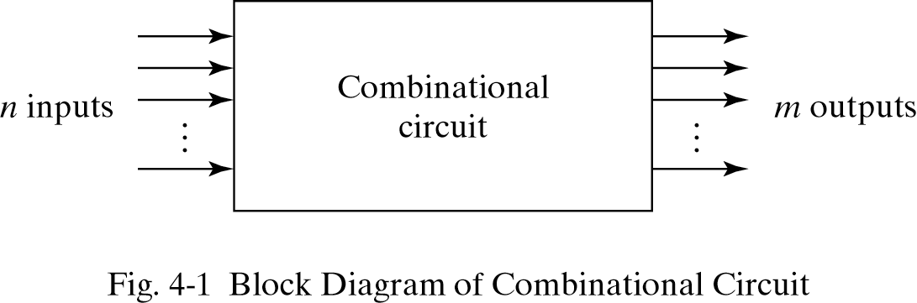
Combinational Logic
Logic circuits for digital systems may be combinational or sequential.
A combinational circuit consists of input variables, logic gates, and output variables.

Slide 3
Design Procedure
The design procedure for combinational logic circuits are:
Determine required number of inputs and outputs from the specifications.
Derive the truth table for each of the outputs based on their relationships to the input.
Simplify the Boolean expression for each output. Use Karnaugh Maps or Boolean algebra.
Draw a logic diagram that represents the simplified Boolean expression.

Slide 4
Half Adder
A combinational circuit that performs the addition of two bits is called a half adder.
The truth table for the half adder is listed below:
x | y | S | C
0 | 0 | 0 | 0
0 | 1 | 1 | 0
1 | 0 | 1 | 0
1 | 1 | 0 | 1
\
y
x
0 | 1
1 | 0
S = x’y + xy’
C = xy
\
y
x
S(x,y) = ∑m (1,2) C(x,y) = ∑m (3)
0 | 0
0 | 1

Slide 5
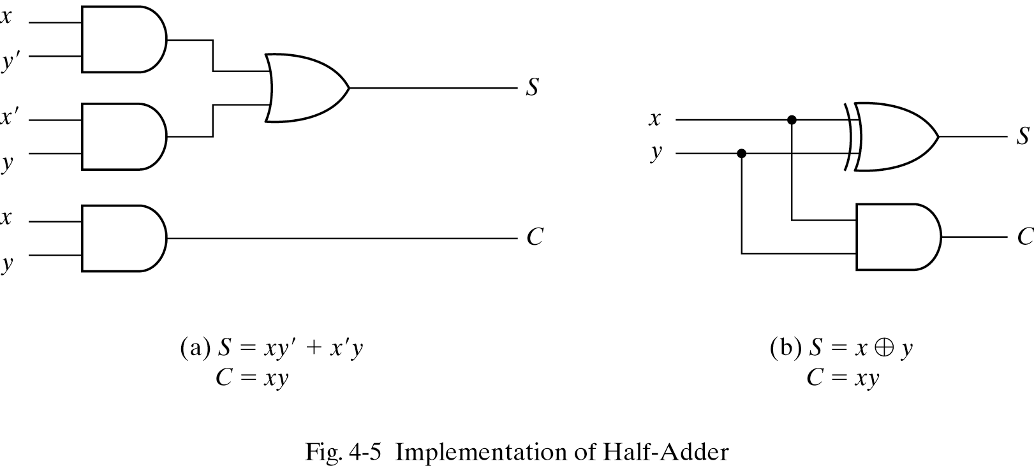
Implementation of Half-Adder
S = x’y + xy’ or x⊕y
C=xy

Slide 6
Full-Adder
One that performs the addition of three bits(two significant bits and a previous carry) is a full adder.
x | y | z | S | C
0 | 0 | 0 | 0 | 0
0 | 0 | 1 | 1 | 0
0 | 1 | 0 | 1 | 0
0 | 1 | 1 | 0 | 1
1 | 0 | 0 | 1 | 0
1 | 0 | 1 | 0 | 1
1 | 1 | 0 | 0 | 1
1 | 1 | 1 | 1 | 1
S(x,y,z) = ∑m (1,2,4,7) C(x,y,z) = ∑m (3,5,6,7)

Slide 7
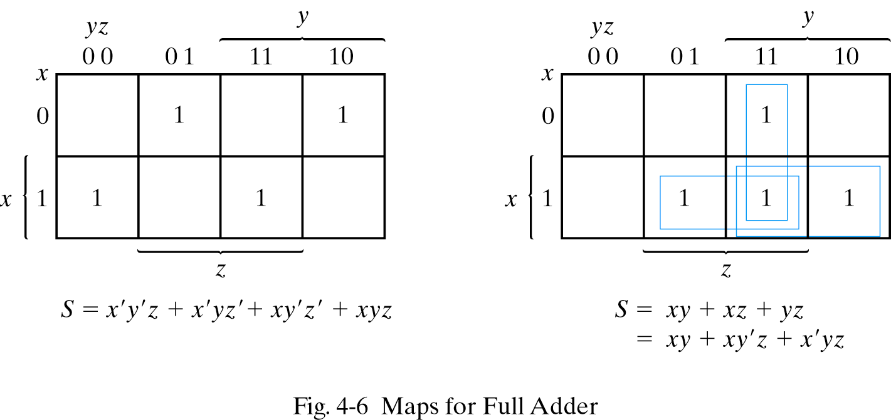
Simplified Expressions
C
S = x’y’z + x’yz’ + xy’z’ + xyz or (x⊕ y⊕z)
C = xy + xz + yz

Slide 8
Full-Adder
S = x’y’z + x’yz’ + xy’z’ + xyz
= x’(y’z+yz’) + x(y’z’+yz)
= x’(y⊕z) + x(y⊕z)’ [y⊕z=A]
= x’A+xA’
= x⊕A
= (x⊕ y⊕z)

Slide 9
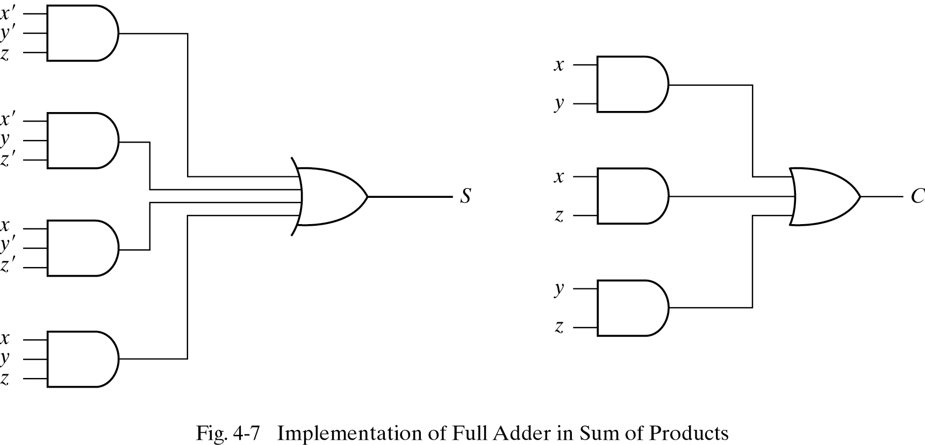
Full-Adder
S = x’y’z + x’yz’ + xy’z’ + xyz
C = xy + xz + yz

Slide 10
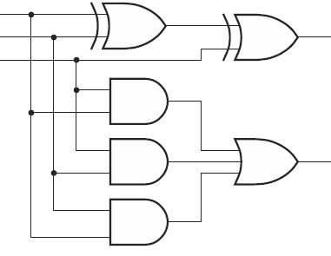
Full-Adder
x
y
z
S=(x⊕ y⊕z)
C = xy + xz + yz

Slide 11
Half-Subtractor
One that performs the subtraction of two bits is half subtractor.
a | b | D | B
0 | 0 | 0 | 0
0 | 1 | 1 | 1
1 | 0 | 1 | 0
1 | 1 | 0 | 0
D(a,b) = ∑m (1,2) B(a,b) = ∑m (1)

Slide 12
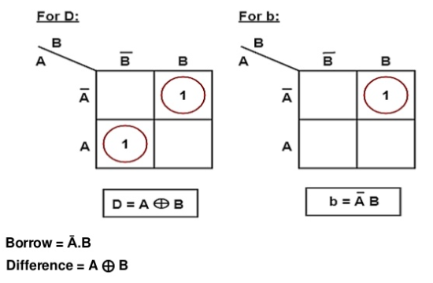
Half-Subtractor
D(a,b) = ∑m (1,2) B(a,b) = ∑m (1)

Slide 13
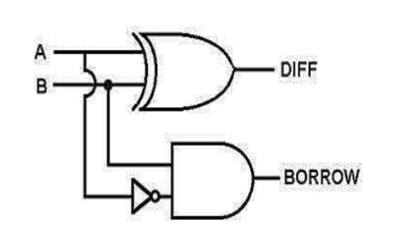
Half-Subtractor
A⊕B
B
A’
A’B

Slide 14
Full-Subtractor
One that performs the subtraction of three bits is Full subtractor.
a | b | c | D | B
0 | 0 | 0 | 0 | 0
0 | 0 | 1 | 1 | 1
0 | 1 | 0 | 1 | 1
0 | 1 | 1 | 0 | 1
1 | 0 | 0 | 1 | 0
1 | 0 | 1 | 0 | 0
1 | 1 | 0 | 0 | 0
1 | 1 | 1 | 1 | 1
D(a,b,c) = ∑m (1,2,4,7) B(a,b,c) = ∑m (1,2,3,7)

Slide 15
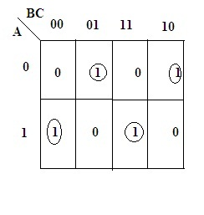
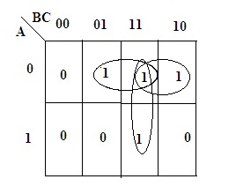
Full-Subtractor
bc
bc
a
a
Difference(D)=a⊕b⊕c
Borrow(B)=a’c+bc+a’b
D(a,b,c) = ∑m (1,2,4,7) B(a,b,c) = ∑m (1,2,3,7)

Slide 16
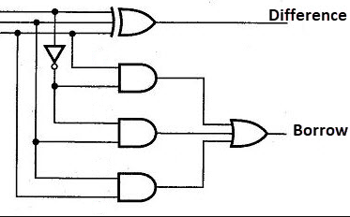
Full-Subtractor
a
b
c
D=a⊕b⊕c
B=a’c+bc+a’b

Slide 17
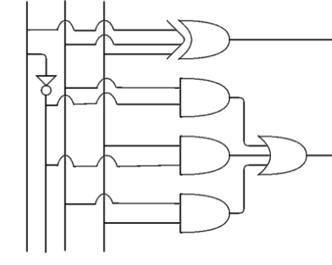
Full-Subtractor
a b c
D=a⊕b⊕c
b
a’
c
a’
b
c
B=a’c+bc+a’b

Slide 18
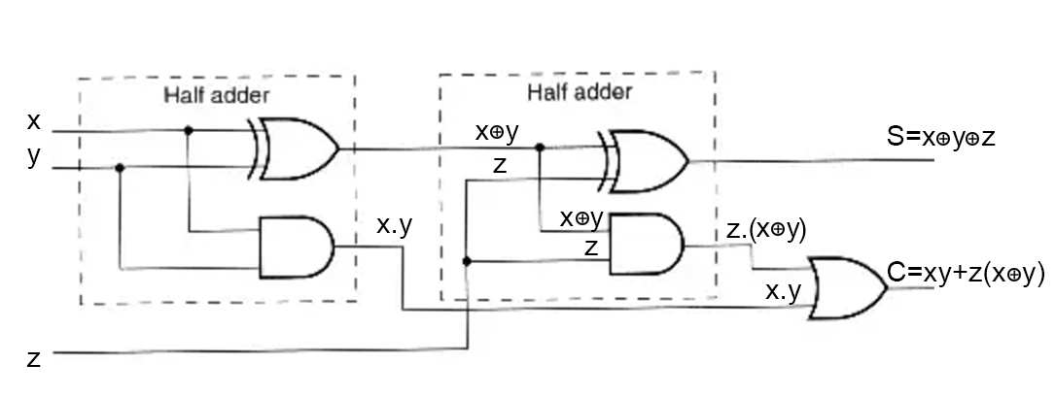
Design a full adder circuit using two half adders. Also verify your answer.
Full Adder
S=(x⊕ y⊕z)
C = xy + xz + yz
Half Adder
S=(x⊕ y)
C = xy
From above circuit:
S = (x⊕ y⊕z)
C = xy+z (x⊕ y)
= xy+z(x’y+xy’)
= xy+x’yz+xy’z
From actual Full adder circuit:
C = xy + xz + yz
C = xy + xz(y+y’) + yz(x+x’)
C = xy+xyz+xy’z+xyz+x’yz
C = xy+xyz+xy’z+x’yz
C = xy(1+z)+xy’z+x’yz
C = xy+x’yz+xy’z

Slide 19
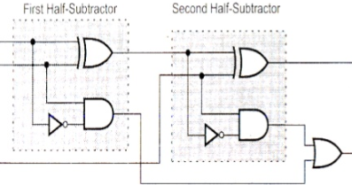
Construct a full subtractor circuit using two half
subtractors. Also verify your answer.
x
y
z
D= (x⊕ y⊕z)
B= x’y+z (x⊕y)’
From above circuit:
B = x’y+z (x⊕y)’
B = x’y+z(xy+x’y’)
B = x’y+xyz+x’y’z
But from the actual Full subtractor circuit:
B = x’y+yz+x’z
B = x’y+yz(x+x’)+x’z(y+y’)
B = x’y+xyz+x’yz+x’yz+x’y’z
B = x’y+xyz+x’yz+x’y’z
B = x’y+x’yz+xyz+x’y’z
B = x’y(1+z)+xyz+x’y’z
B = x’y. +xyz+x’y’z verified.

Slide 20
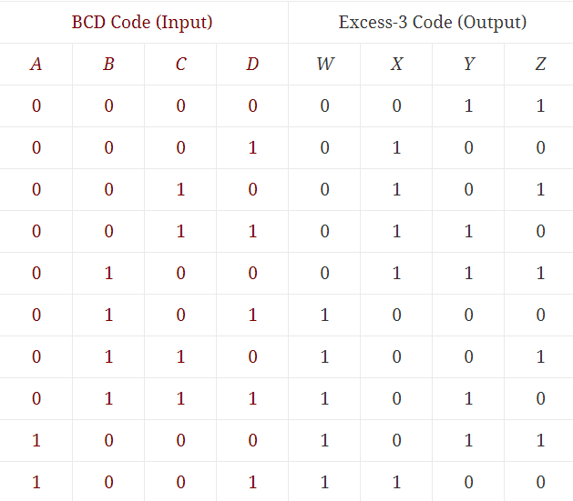
Code Conversion Circuit
Design a converter circuit which converts BCD to excess 3.
Don’t care conditions:
m₁₀-m₁₅
W(A,B,C,D) = ∑m (5,6,7,8,9)
X(A,B,C,D) = ∑m (1,2,3,4,9)
Y(A,B,C,D) = ∑m (0,3,4,7,8)
Z(A,B,C,D) = ∑m (0,2,4,6,8)

Slide 21
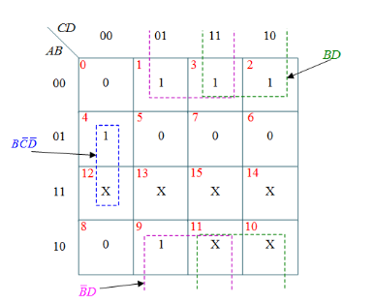
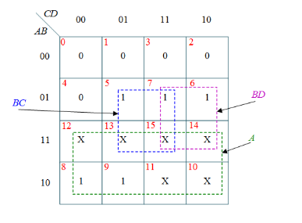
Code Conversion Circuit
W(A,B,C,D) = ∑m (5,6,7,8,9) X(A,B,C,D) = ∑m (1,2,3,4,9)
W=A+BC+BD X=B’C+B’D+BC’D’

Slide 22
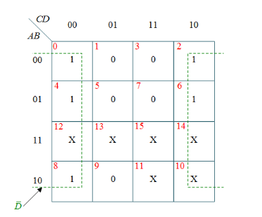
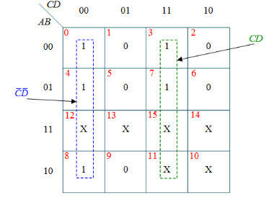
Code Conversion Circuit
Y(A,B,C,D) = ∑m (0,3,4,7,8) Z(A,B,C,D) = ∑m (0,2,4,6,8)
Y=CD+C’D’ Z=D’

Slide 23
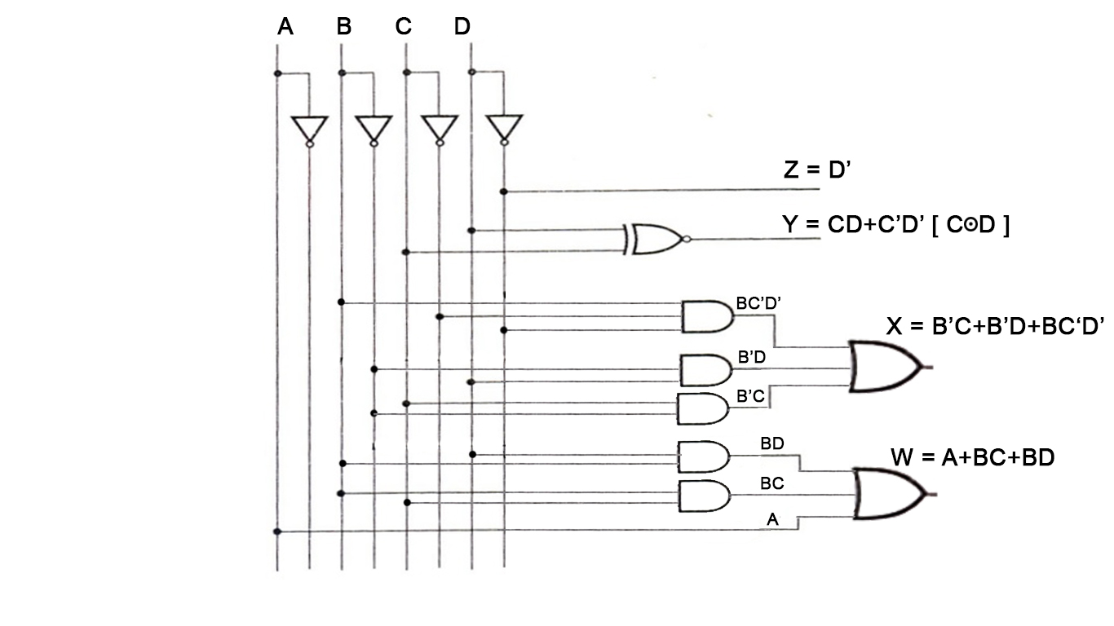
Code Conversion Circuit
BCD to Excess-3 Code Converter Logic Diagram

Slide 24
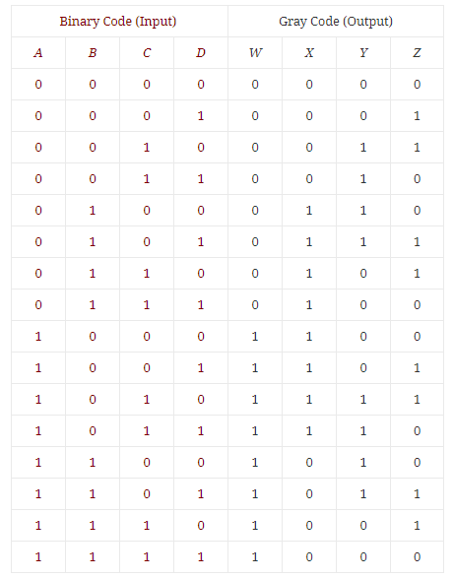
Code Conversion Circuit
Design a converter circuit
which converts Binary to Gray.
W(A,B,C,D) = ∑m (8,9,10,11,12,13,14,15)
X(A,B,C,D) = ∑m (4,5,6,7,8,9,10,11)
Y(A,B,C,D) = ∑m (2,3,4,5,10,11,12,13)
Z(A,B,C,D) = ∑m (1,2,5,6,9,10,13,14)

Slide 25
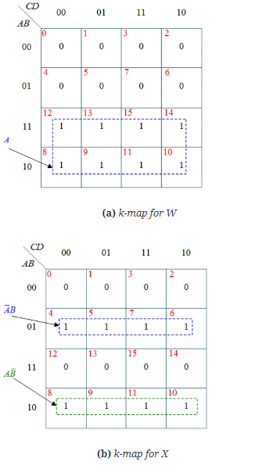
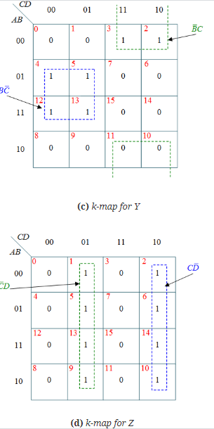
Code Conversion Circuit

Slide 26
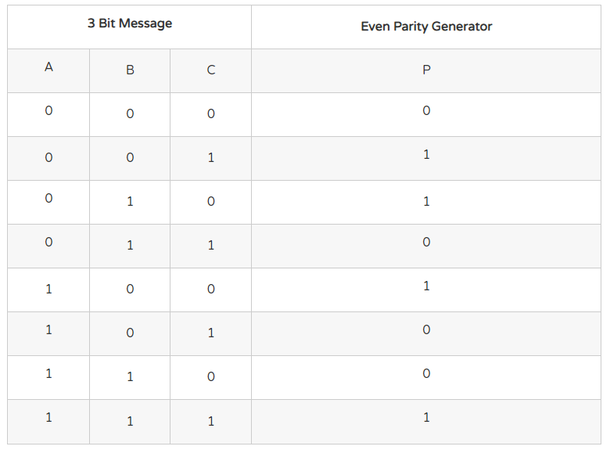
Parity Generator Circuit
EVEN PARITY
P(A,B,C) = ∑m (1,2,4,7)

Slide 27
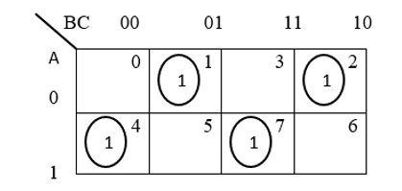
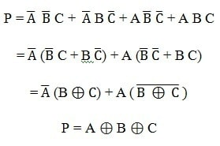
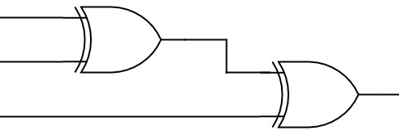
Parity Generator Circuit
P(A,B,C) = ∑m (1,2,4,7)
A
B
C
P
3 bit even parity generator circuit

Slide 28
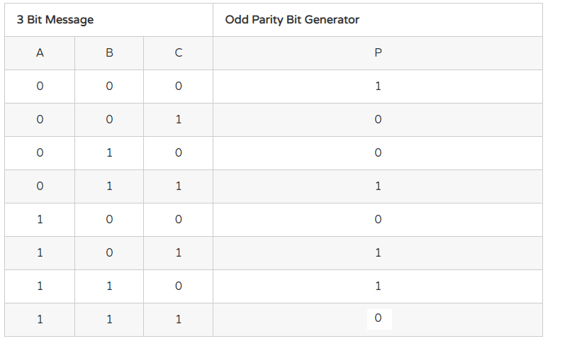
Parity Generator Circuit
ODD PARITY
P(A,B,C) = ∑m (0,3,5,6)

Slide 29
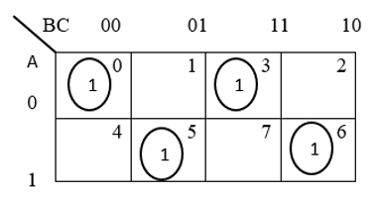
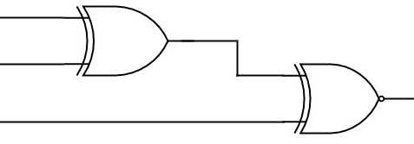
Parity Generator Circuit
P(A,B,C) = ∑m (0,3,5,6)
P=A’B’C’+A’BC+AB’C+ABC’
P=C’(A’B’+AB)+C(A’B+AB’)
P=C’ (A⊕B)’ + C (A⊕B)
P=C’X’ + CX [X= (A⊕B)]
P=C⊙X
P=C⊙(A⊕B)
P= (A⊕B) ⊙ C
A
B
C
P
3 bit odd parity generator circuit

Slide 30
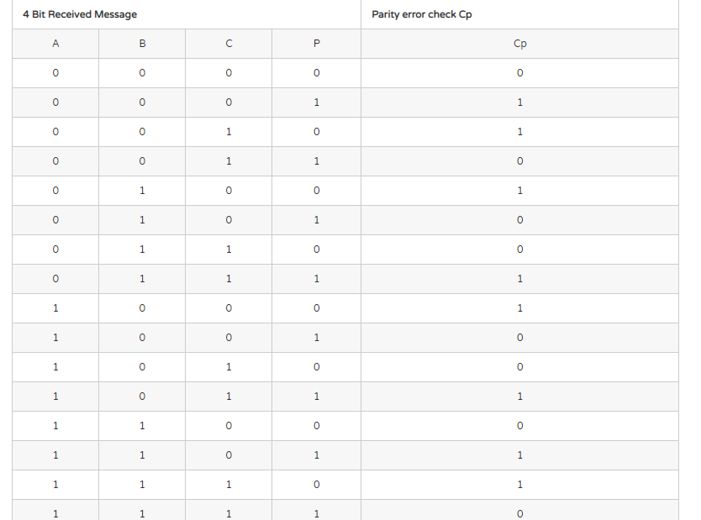
Parity Checker Circuit
Even Parity
Check
Cp(A,B,C,P) =
∑m (1,2,4,7,8,11,13,14)
Cp=1 for error

Slide 31
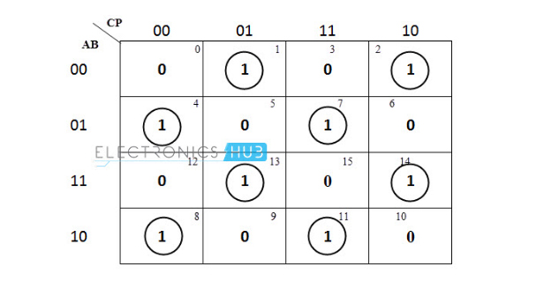
Parity Checker Circuit
Cp(A,B,C,P) = ∑m (1,2,4,7,8,11,13,14)
Cp= (A⊕B)⊕(C⊕P)

Slide 32
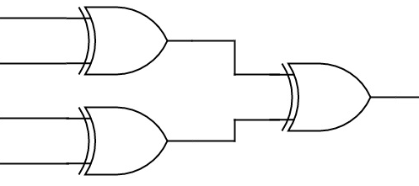
Parity Checker Circuit
A
B
C
P
Cp
3 bit message even parity checker circuit

Slide 33
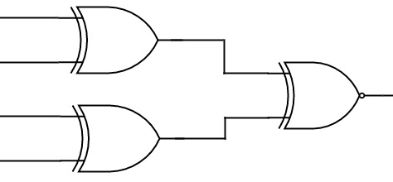
Parity Checker Circuit
Odd Parity
Check
A
B
C
P
Cp
3 bit message odd parity checker circuit
Cp= (A⊕B) ⊙(C⊕P)

Slide 34
Code Conversion Circuit
Decimal | 8 4 -2 -1 | 2 4 2 1
 | A B C D | W X Y Z
0 | 0 0 0 0 (m₀) | 0 0 0 0
1 | 0 1 1 1 (m₇) | 0 0 0 1
2 | 0 1 1 0 (m₆) | 0 0 1 0
3 | 0 1 0 1 (m₅) | 0 0 1 1
4 | 0 1 0 0 (m₄) | 0 1 0 0
5 | 1 0 1 1 (m₁₁) | 1 0 1 1
6 | 1 0 1 0 (m₁₀) | 1 1 0 0
7 | 1 0 0 1 (m₉) | 1 1 0 1
8 | 1 0 0 0 (m₈) | 1 1 1 0
9 | 1 1 1 1 (m₁₅) | 1 1 1 1
Design a converter
circuit which converts
84 -2 -1 to 2421 code.
Don’t care conditions:
m₁,m₂,m₃,m₁₂,m₁₃,m₁₄
W(A,B,C,D) = ∑m (8,9,10,11,15)
X(A,B,C,D) = ∑m (4,8,9,10,15)
Y(A,B,C,D) = ∑m (5,6,8,11,15)
Z(A,B,C,D) = ∑m (5,7,9,11,15)

Slide 35
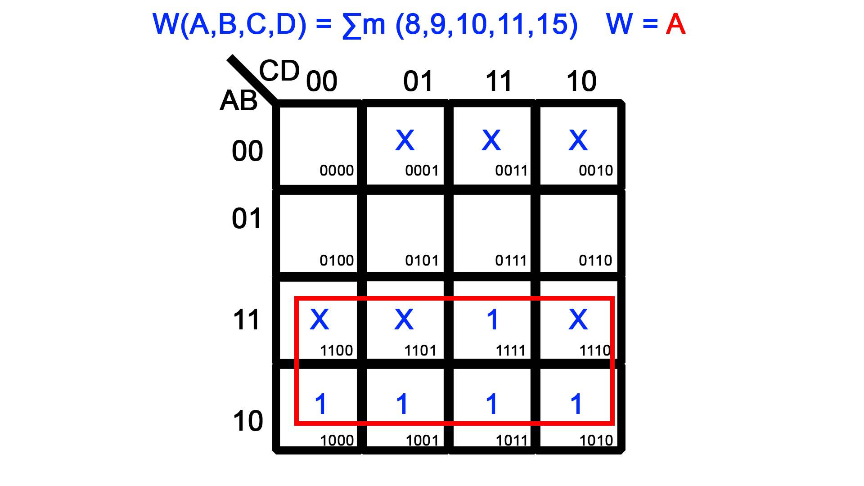
Code Conversion Circuit
Design a converter
circuit which converts
84 -2 -1 to 2421 code.

Slide 36
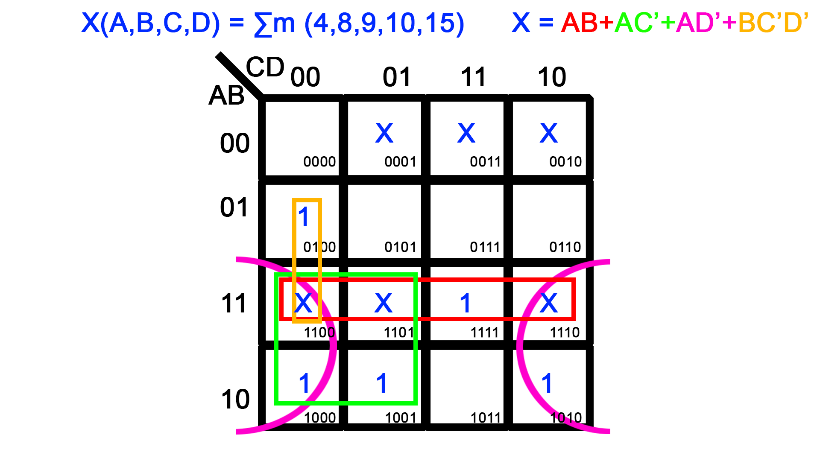
Code Conversion Circuit
Design a converter
circuit which converts
84 -2 -1 to 2421 code.

Slide 37
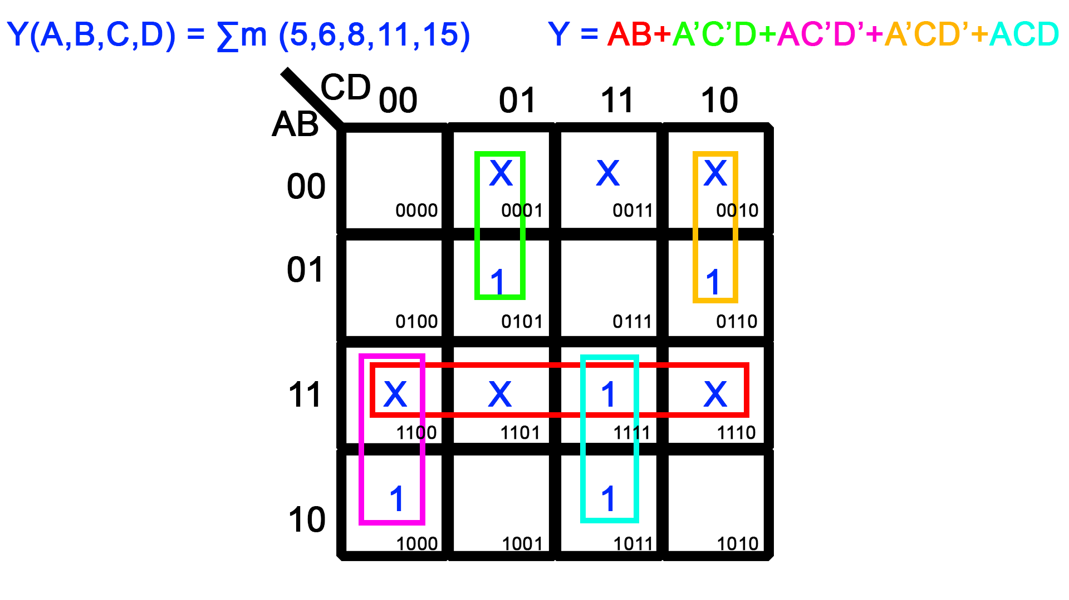
Code Conversion Circuit
Design a converter
circuit which converts
84 -2 -1 to 2421 code.

Slide 38
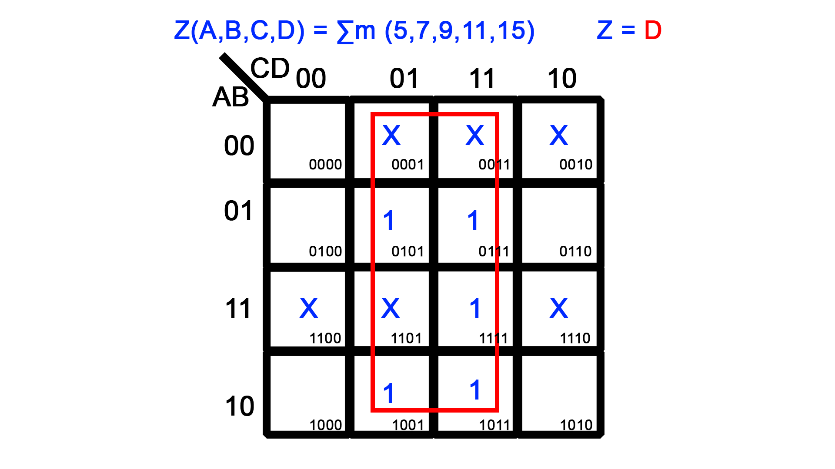
Code Conversion Circuit
Design a converter
circuit which converts
84 -2 -1 to 2421 code.

Slide 39
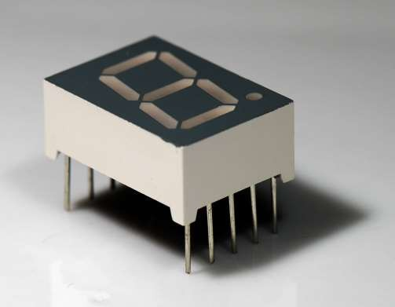
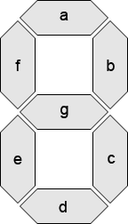
Seven Segment Display

Slide 40
Seven Segment Display
7 LEDs (light emitting diodes), each one controlled by an input.
A seven-segment decoders can be used to display the decimal numbers 0-9 and some alpha characters.

Slide 41
Display Possibilities
Select Alpha Characters
Simple Messages

Slide 42
Seven Segment Display
Input is a 4-bit BCD code → 4 inputs (A, B, C, D)
Output is a 7-bit code (a,b,c,d,e,f,g) that allows for the decimal equivalent to be
a
Displayed Example:
– Input: (0000)_{BCD}
– Output: 1111110 (a=b=c=d=e=f=1, g=0)
f
g
b
e
c
d

Slide 43
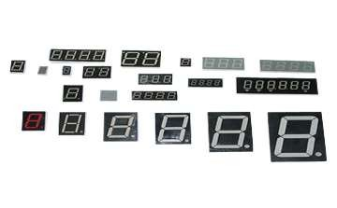
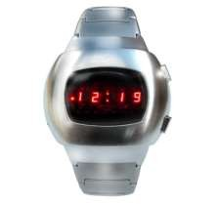
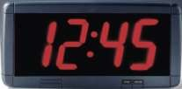
Applications

Slide 44
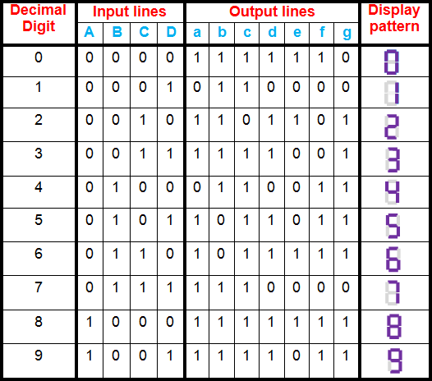
Truth Table for 7 Segment Decoder

Slide 45
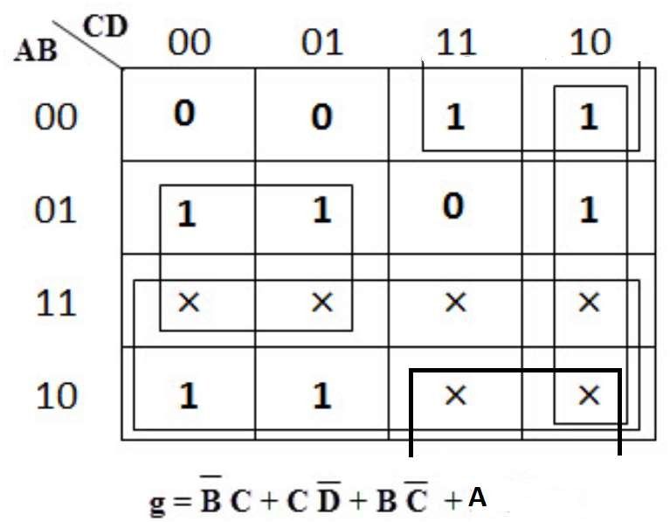
Expression for segment g
g (A,B,C,D) = ∑m (2, 3, 4, 5, 6, 8, 9) and ∑d (10,11,12,13,14,15)

Slide 46
Draw K MAP for all the 7 expressions: a,b,c,d,e,f,g and draw the logic diagram

